Slide 1
Data Visualization Laboratory BCS358D
Experiment No.
1BY22IS075– LOKESH
1BY22IS076-MOHAMMED MISHAL
1BY22IS077-MAANYA

Slide 2
QUESTION 4
a) Write a Python program to Demonstrate how to Draw a Bar Plot using Matplotlib.
b) Write a Python program to Demonstrate how to Draw a Scatter Plot using Matplotlib.

Slide 3
PROGRAMMING CONSTRUCT 4(a)
import matplotlib.pyplot as plt
# Sample data
categories = ['Category A', 'Category B', 'Category C', 'Category D’]
values = [25, 40, 30, 35]
# Creating a bar plot
plt.bar(categories, values, color='skyblue’)
# Adding labels and Title
plt.xlabel('Categories’)
plt.ylabel('Values’)
plt.title('Bar Plot Example’)
# Display the plot
plt.show()

Slide 4
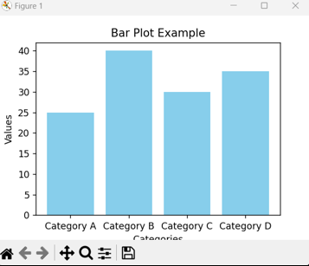
4(a) OUTPUT

Slide 5
4(a) TO READ DATA FROM THE FILE
import random
# Generate some sample data
data = {'Category A': random.randint(1, 10),
'Category B': random.randint(1, 10),
'Category C': random.randint(1, 10)}
# Save data to a file
with open('bar_plot_data.txt', 'w') as file:
for category, value in data.items():
file.write(f'{category} {value}\n')

Slide 6
PROGRAMMING CONSTRUCT 4(b)
import matplotlib.pyplot as plt
# Sample data
x_values = [2, 4, 6, 8, 10]
y_values = [5, 7, 3, 8, 2]
# Creating a scatter plot
plt.scatter(x_values, y_values, color='red', marker='o’)
# Adding labels and title
plt.xlabel('X-axis’)
plt.ylabel('Y-axis’)
plt.title('Scatter Plot Example’)
# Display the plot
plt.show()

Slide 7
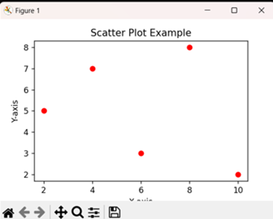
4(b) OUTPUT

Slide 8
4(B)
import matplotlib.pyplot as plt
# Read data from the file
with open('bar_plot_data.txt', 'r') as file:
lines = file.readlines()
categories = [line.split()[0] for line in lines]
values = [int(line.split()[1]) for line in lines]
# Plot the bar graph
plt.bar(categories, values, color='skyblue’)
plt.xlabel('Categories’)
plt.ylabel('Values’)
plt.title('Bar Plot using Matplotlib’)
plt.show()

Slide 9
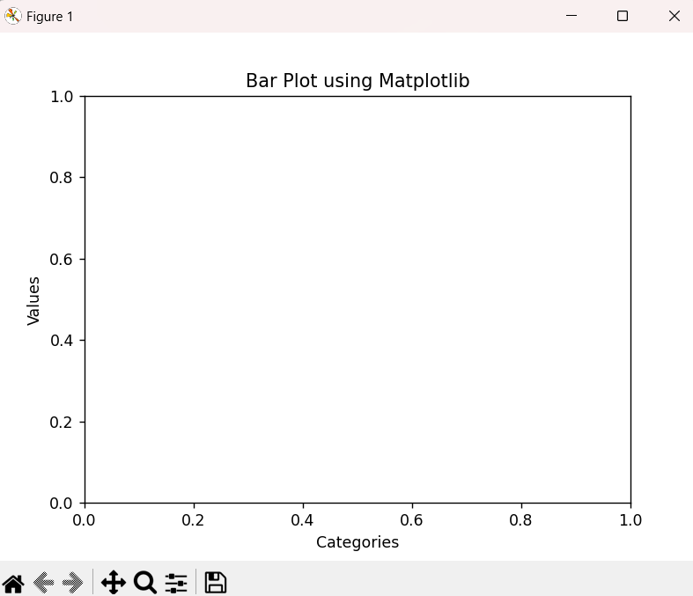
OUTPUT

Slide 10
DATA SET DESCRIPTION
Categories (categories):
It's a list of strings representing the categories for the bar plot. In the example, these are 'Category A', 'Category B', and 'Category C'. You can replace these with your specific categories.
Values (values):
It's a list of numerical values corresponding to each category. In the example, the values are 10, 24, and 15. You can replace these with the actual numerical data you want to visualize.

Slide 11
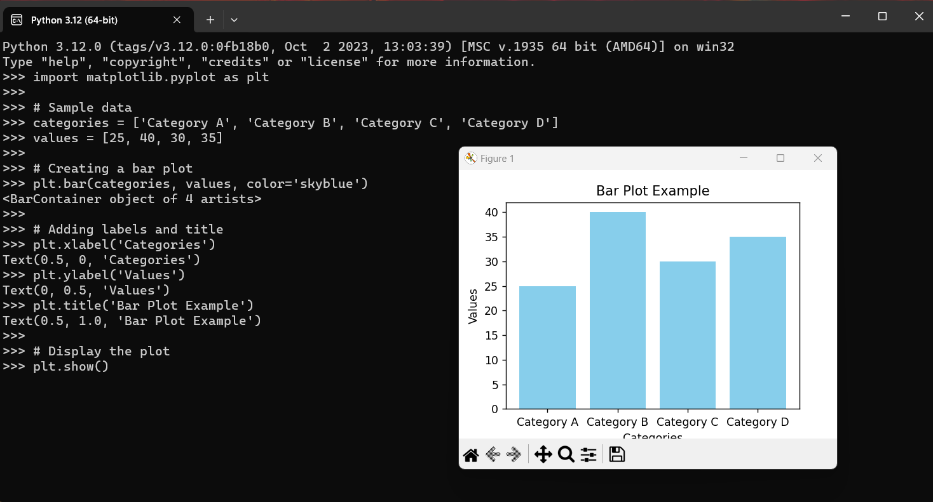

Slide 12
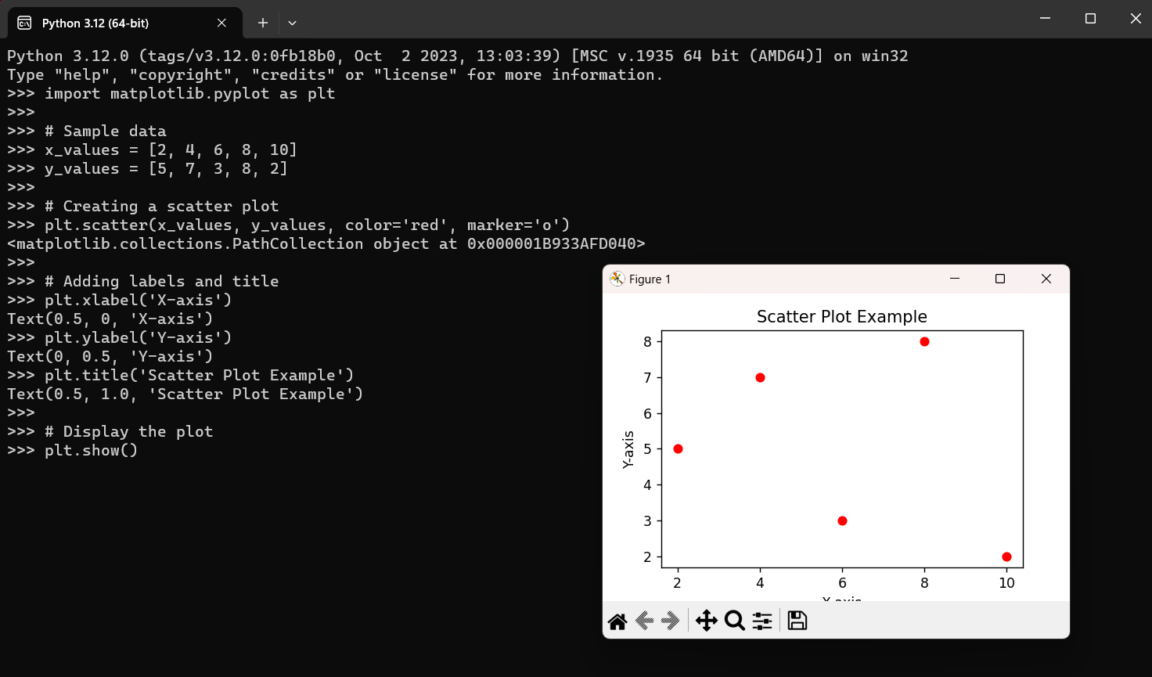

Slide 13
PROGRAMMING CONSTRUCT by CSV file Scatter plot
import matplotlib.pyplot as plt
import pandas as pd
data =pd.read_csv(r"C:Users\11b51\Downloads\data.csv.txt")
x_values = data ['Pregnancies']
y_values = data['Glucose']
plt.scatter(x_values, y_values, color = 'r', marker= 'o')
pit.xlabel ('X-axis Label')
plt.ylabel("Y-axis Label')
plt.title('Scatter Plot Example')
plt.show()

Slide 14
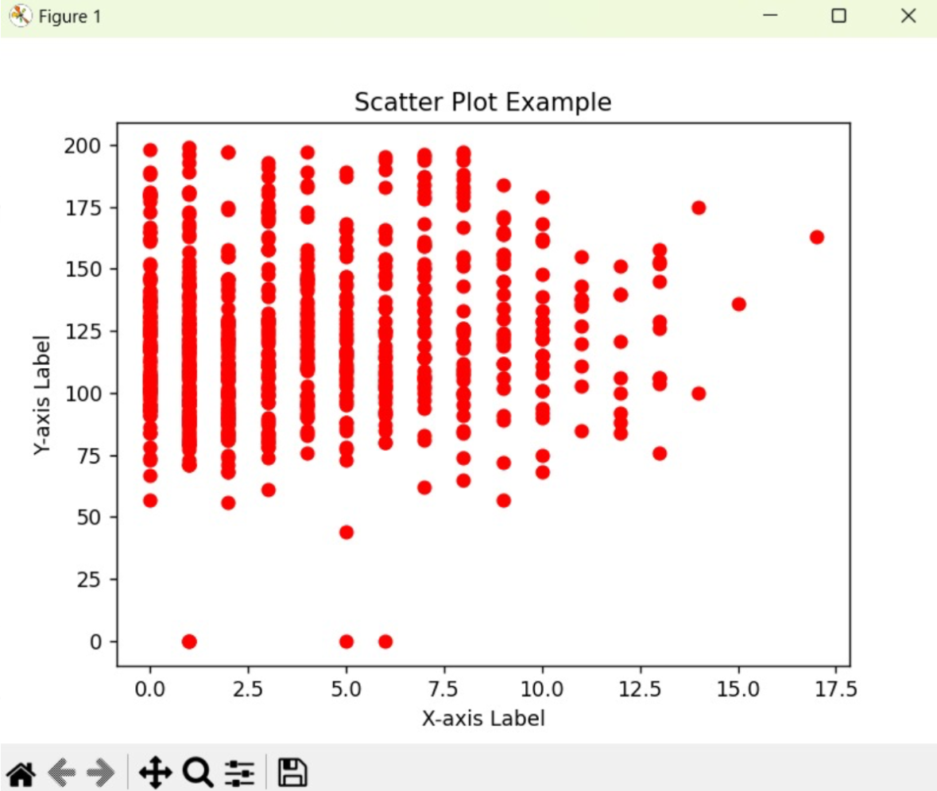

Slide 15
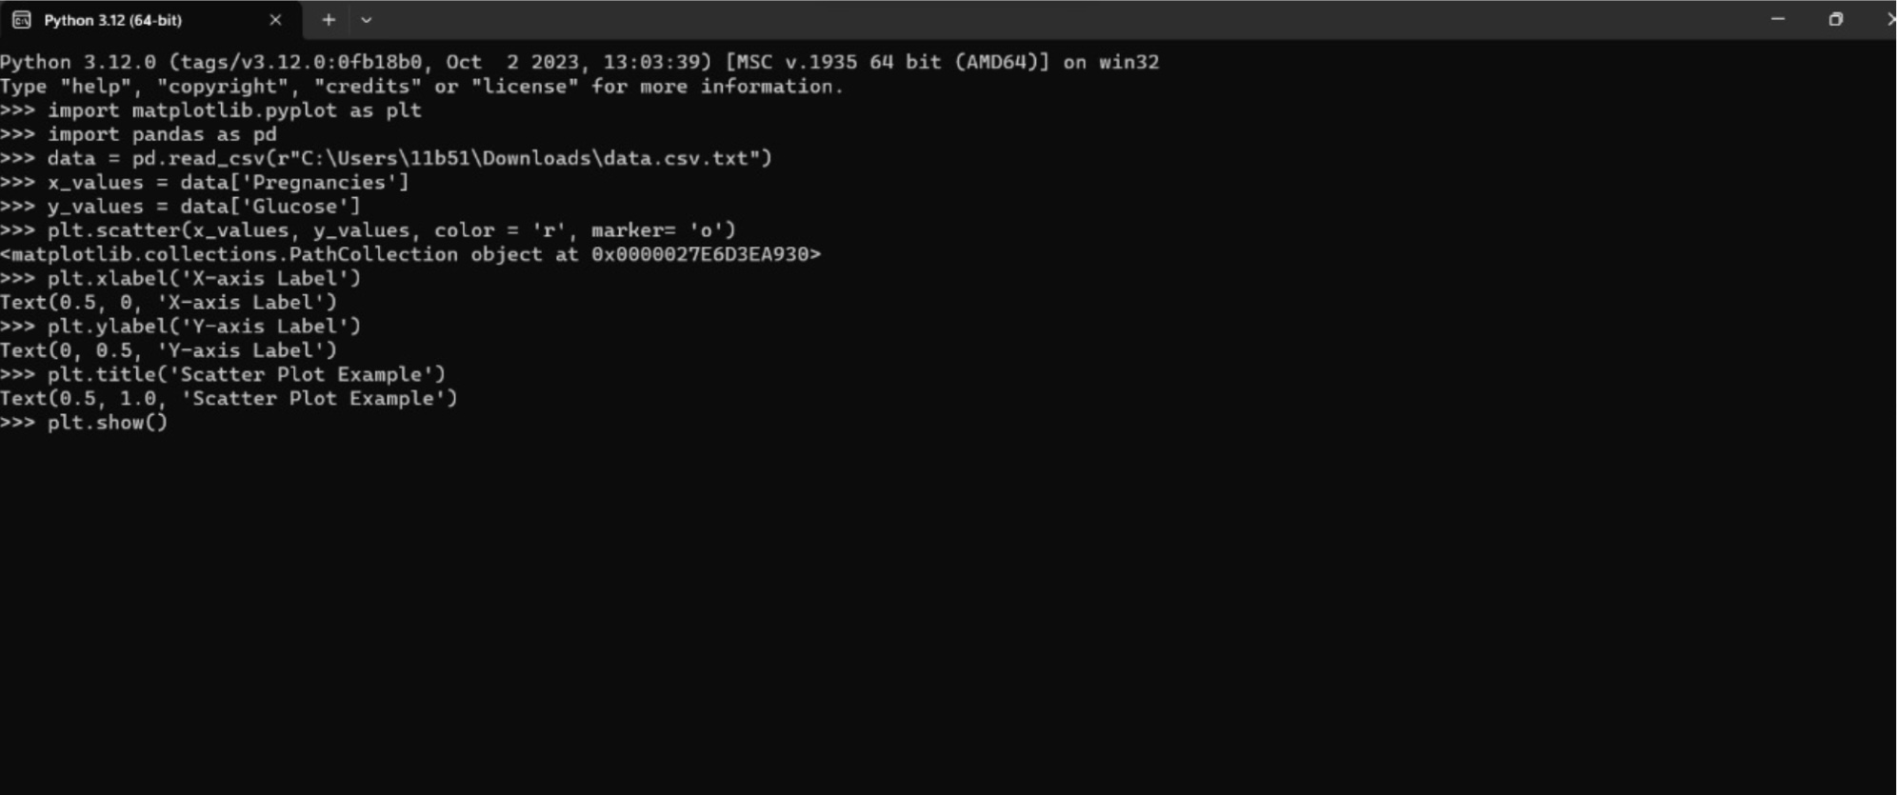
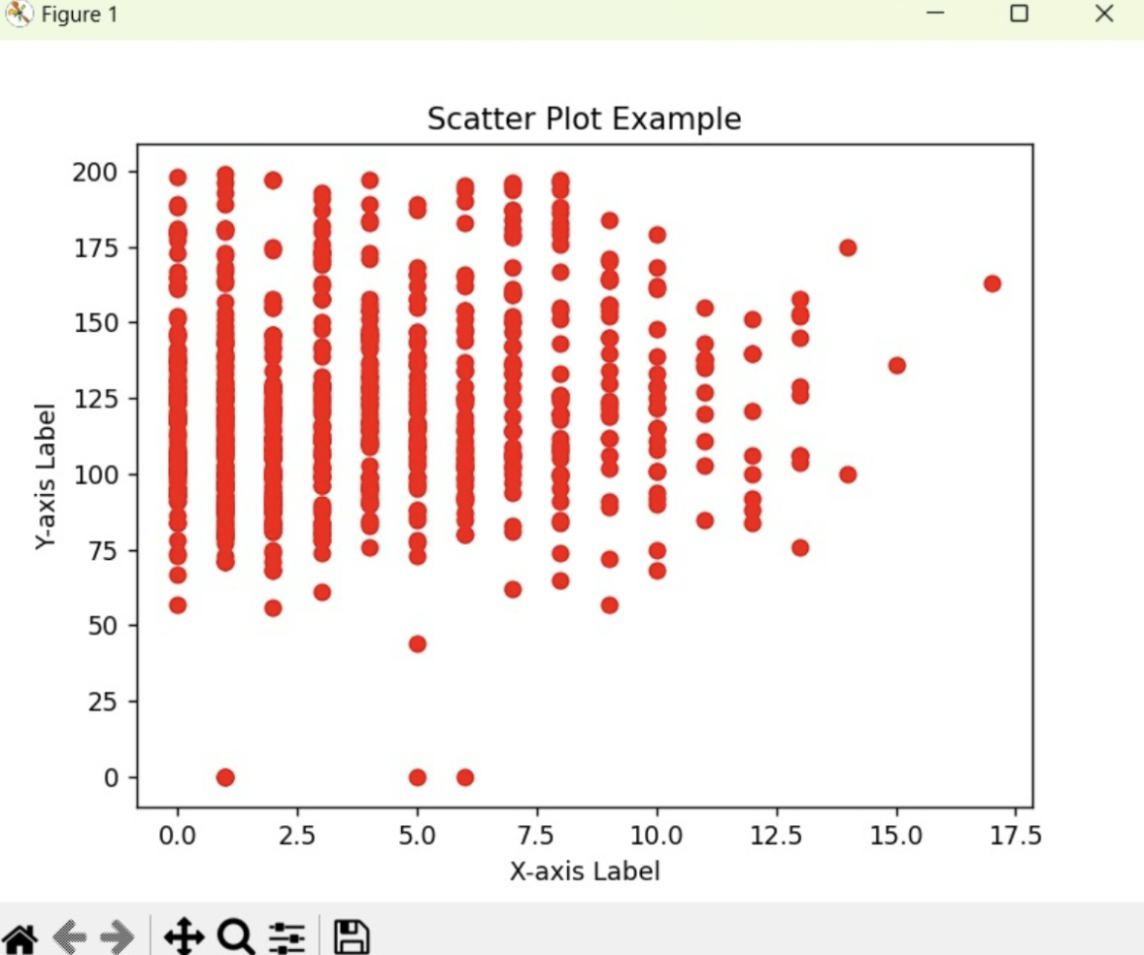

Slide 16
PROGRAMMING CONSTRUCT by CSV file Bar plot
import pandas as pd
import matplotlib.pyplot as plt
csv_file_path =r"C:\Users\11b51\Downloads\data.csv.txt"
data = pd.read_csv(csv_file_path)
categories = data['Pregnancies']
values = data['Glucose']
plt.bar(categories, values, color='blue')
plt.xlabel('Pregnancies')
plt.ylabel('Glucose')
plt.title('Bar Plot from CSV Data')
plt.show()

Slide 17
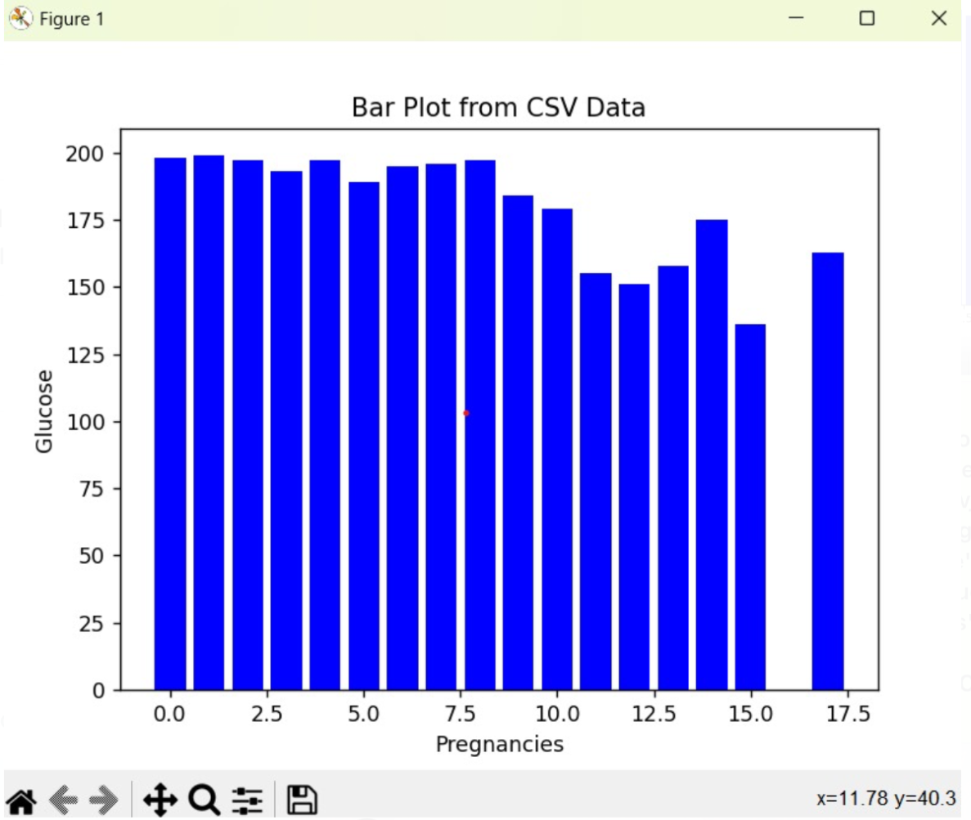

Slide 18
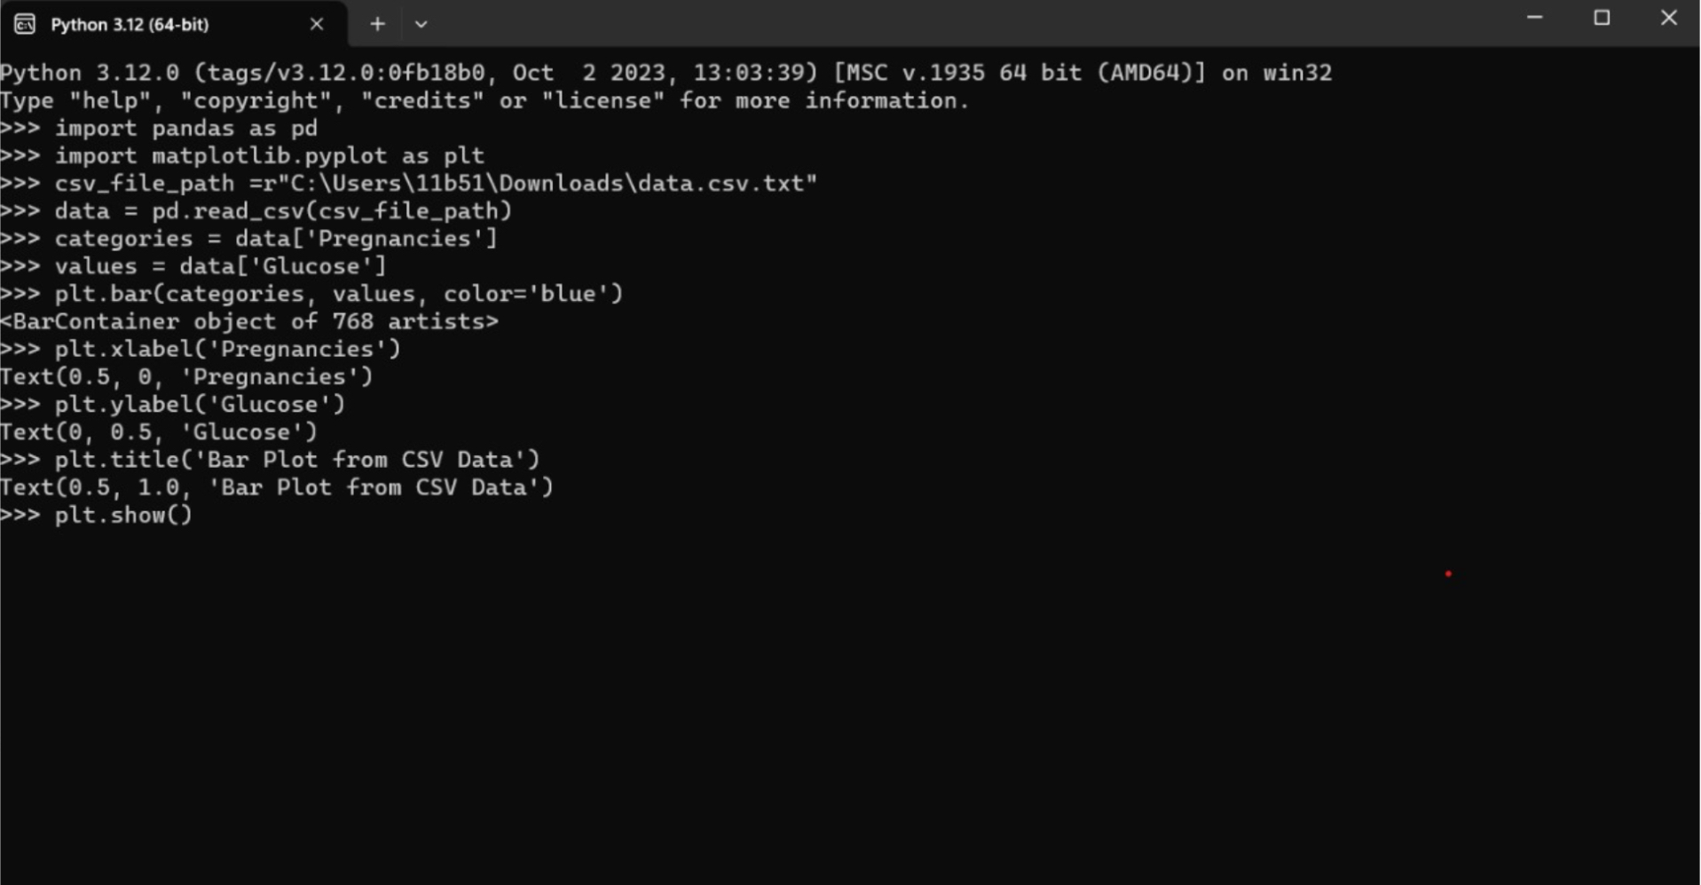


Slide 19
APPLICATIONS
Data Exploration:
Bar Graphs: Displaying categorical data distribution, comparing quantities, or showing trends over time.
Scatter Plots: Exploring relationships between two continuous variables, identifying patterns, and outliers.
Performance Analysis:
Bar Graphs: Comparing performance metrics across different categories or groups.
Scatter Plots: Analyzing correlations between performance variables.
Market Research:
Bar Graphs: Visualizing market share, product sales, or customer satisfaction.
Scatter Plots: Identifying patterns or trends in market behavior.

Slide 20
APPLICATIONS
Scientific Research:
Bar Graphs: Representing experimental results, comparing data sets.
Scatter Plots: Analyzing scientific measurements, exploring relationships between variables.
Finance:
Bar Graphs: Visualizing financial data such as revenue, expenses, and profits.
Scatter Plots: Exploring correlations between financial indicators.
Healthcare Analytics:
Bar Graphs: Comparing patient outcomes, visualizing hospital performance.
Scatter Plots: Analyzing relationships between health parameters.

Slide 21
THANK YOU

